Slide 1
JOURNEY SCRAPBOOK
Custom Bootcamp
Week-2
Radhika Tibrewal

Slide 2
DAY-1
Create A Resource -> Azure Storage Account
Resource Group
Storage Account
Storage Services
Redundancy
Local Redundancy
Zone Redundancy
Geo Redundancy
Geo Zone Redundancy
RAGRS (Read Access Geo Redundant Storage)
Failover
Synchronous Replication
Security
Access Protocols
Access Tiers
Hot
Cold
Cool
Archive Access
Purging & Archiving
Containers - Folder For Storing Files
Azure Tables
Azure Queues
File Shares
Snapshots
Ingress & Egress
Static Website
Azure Storage Types- Day 1

Slide 3
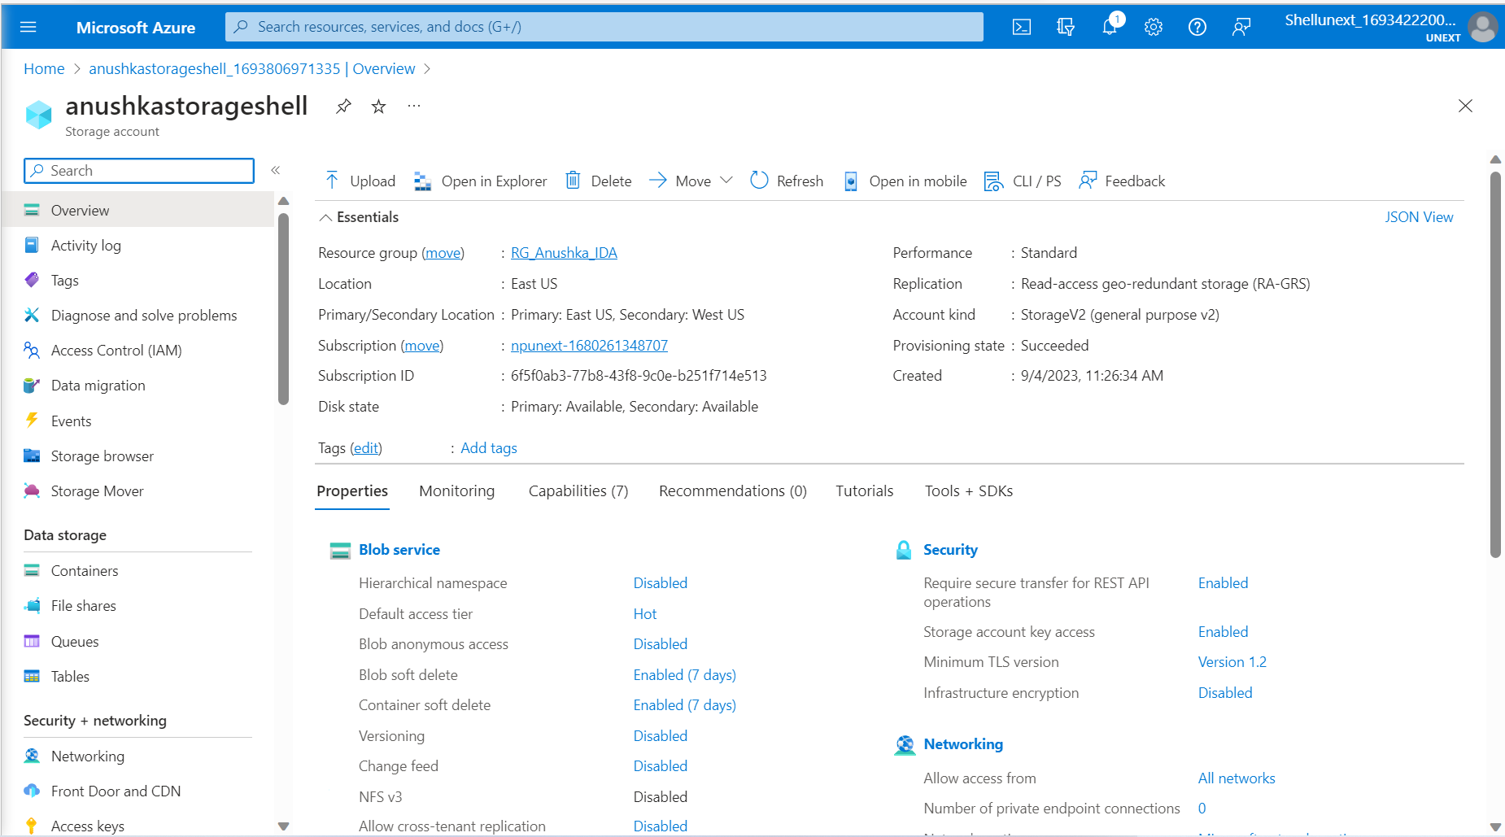
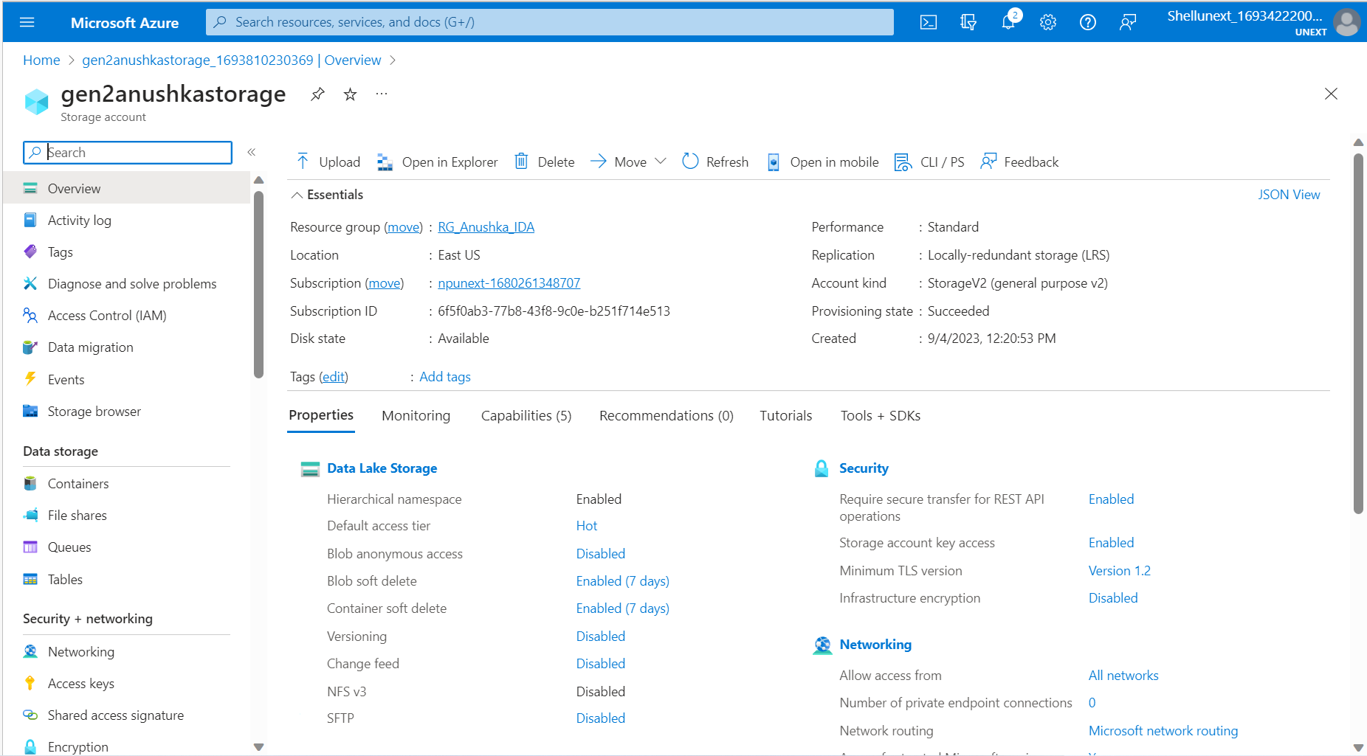
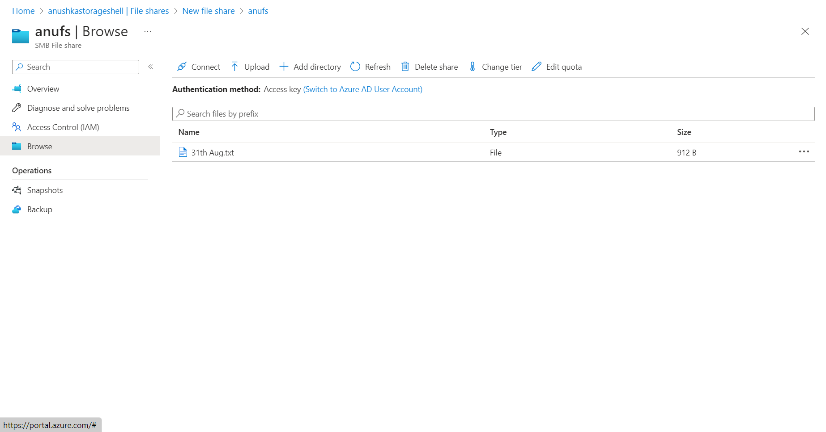
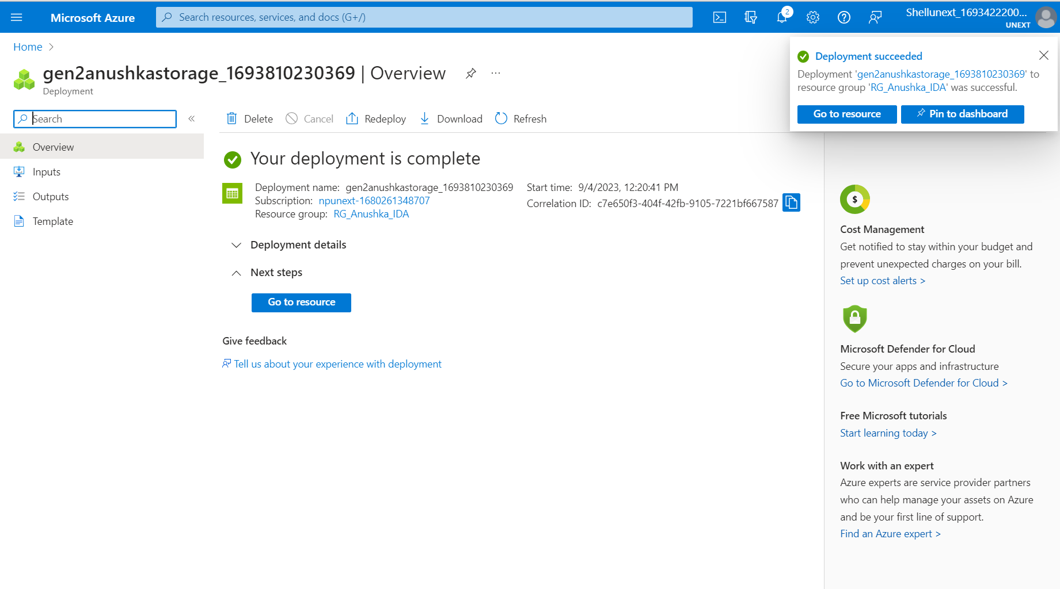
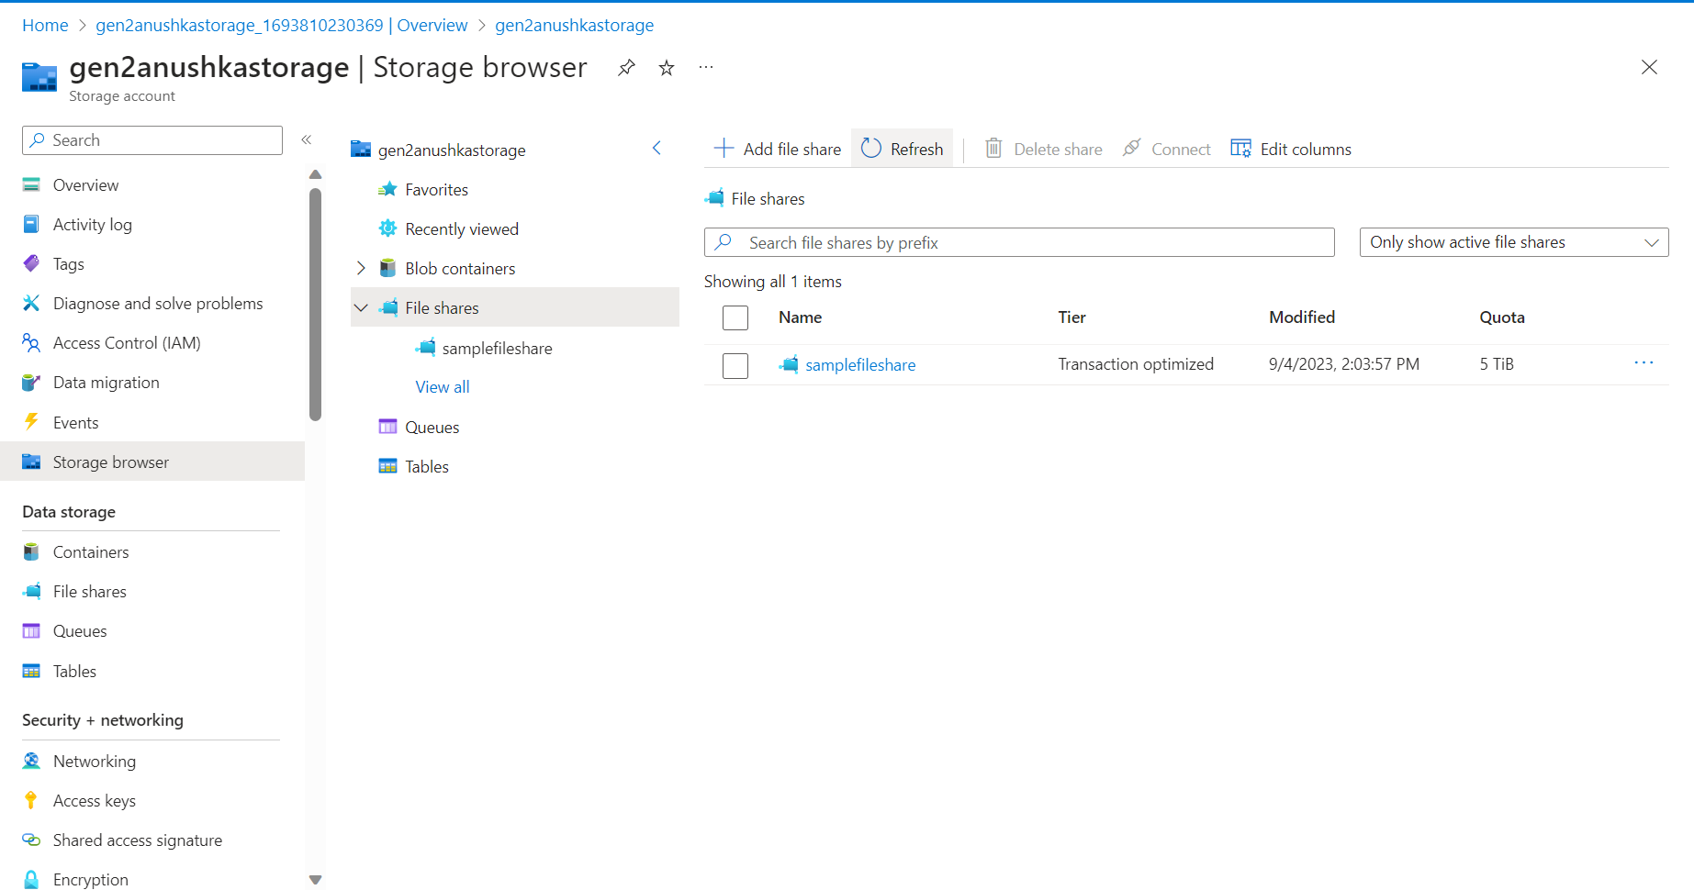
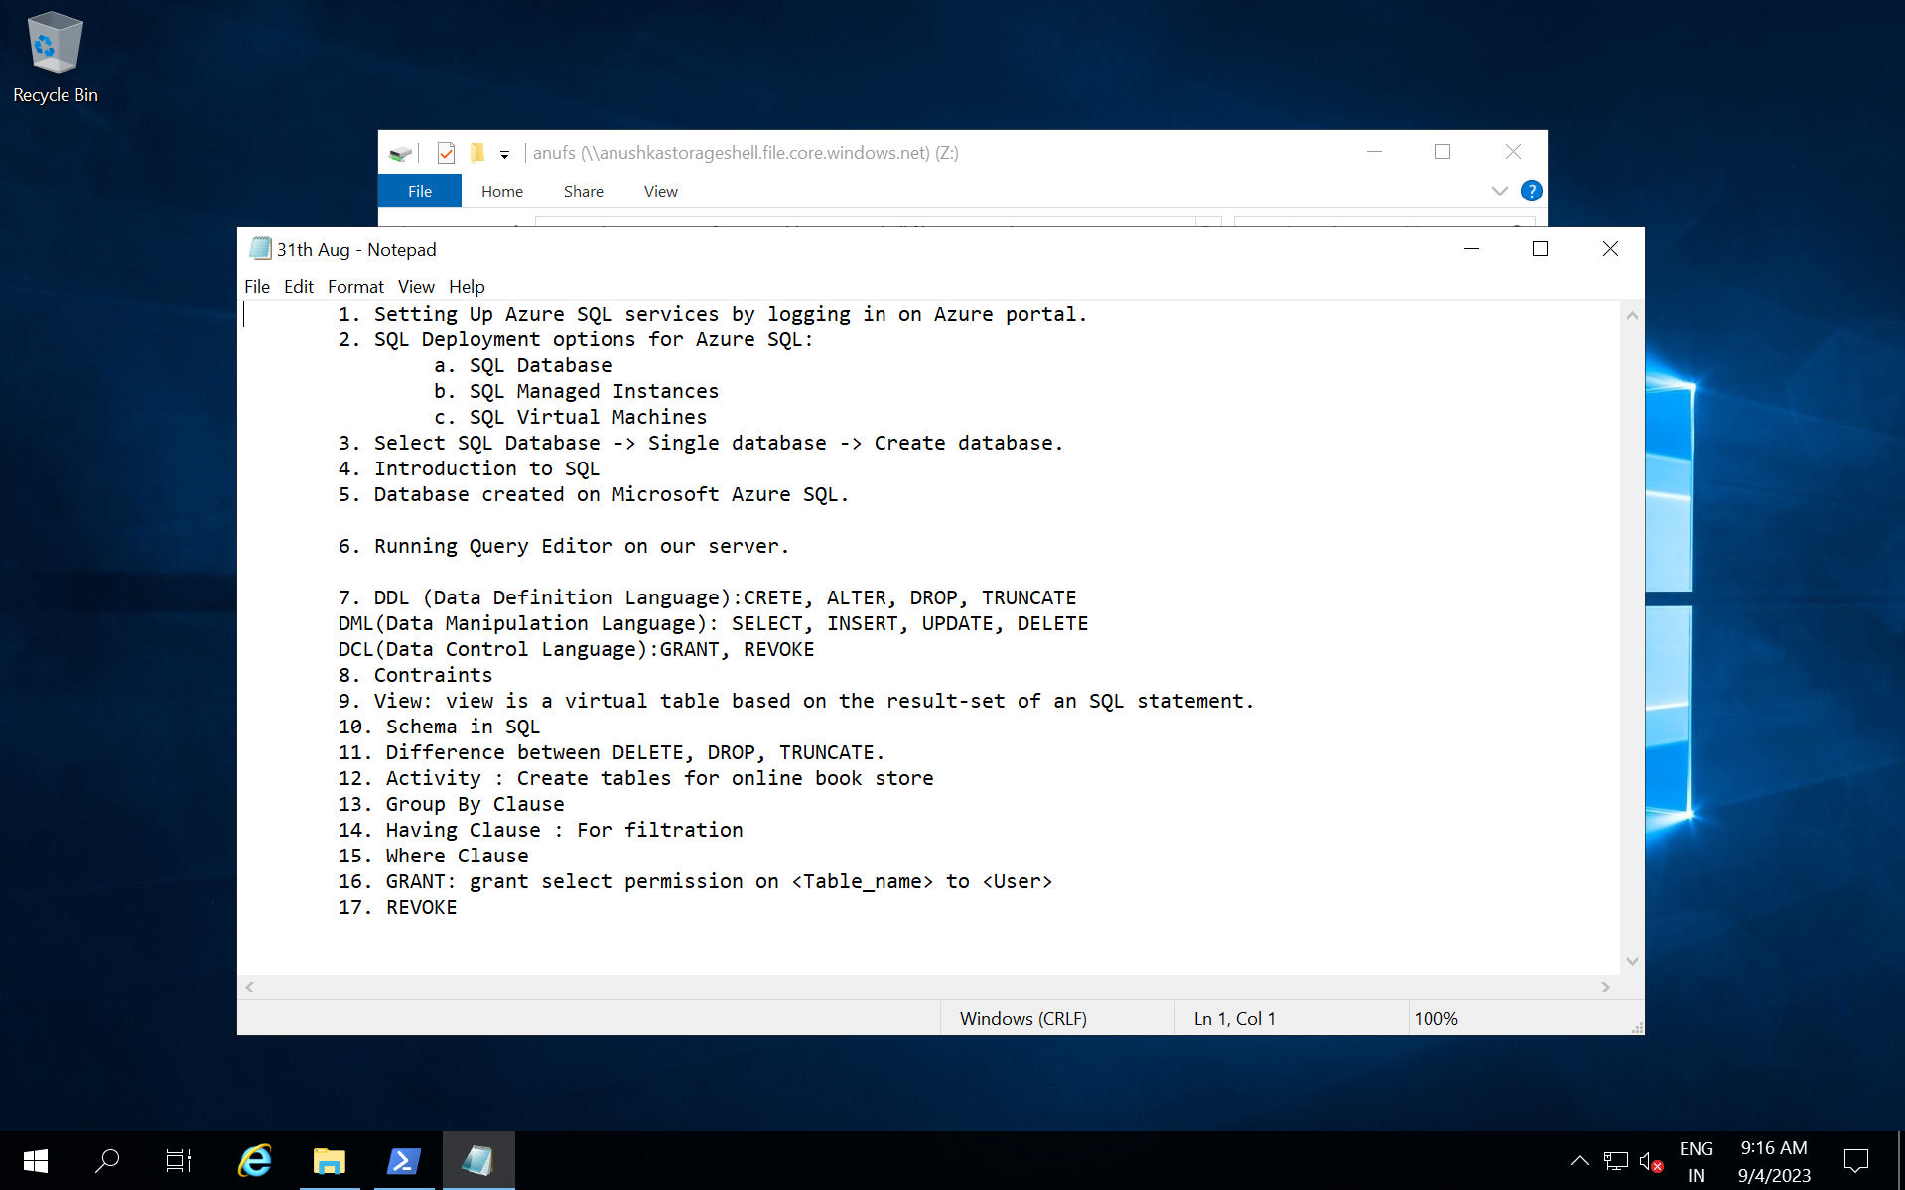
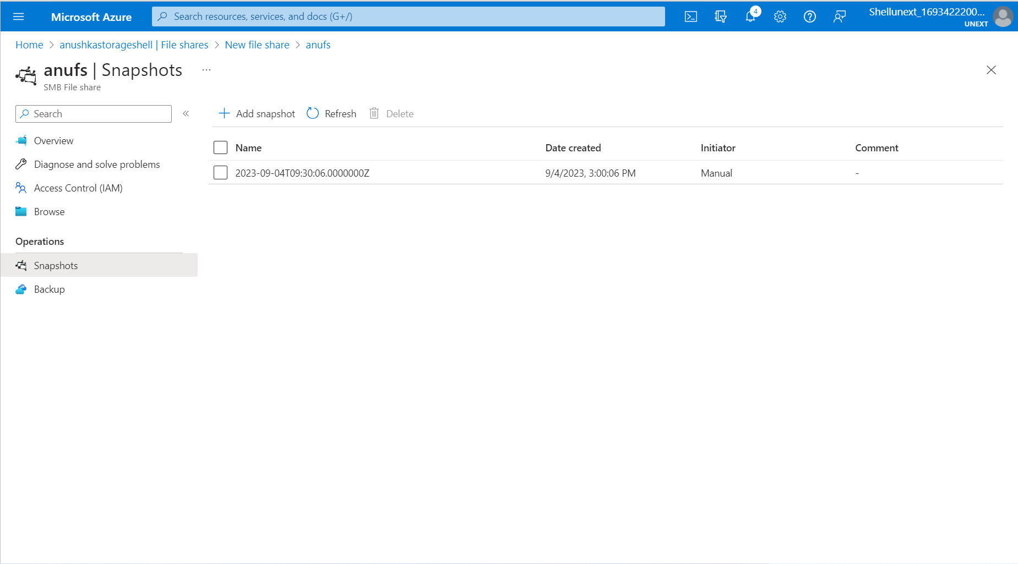
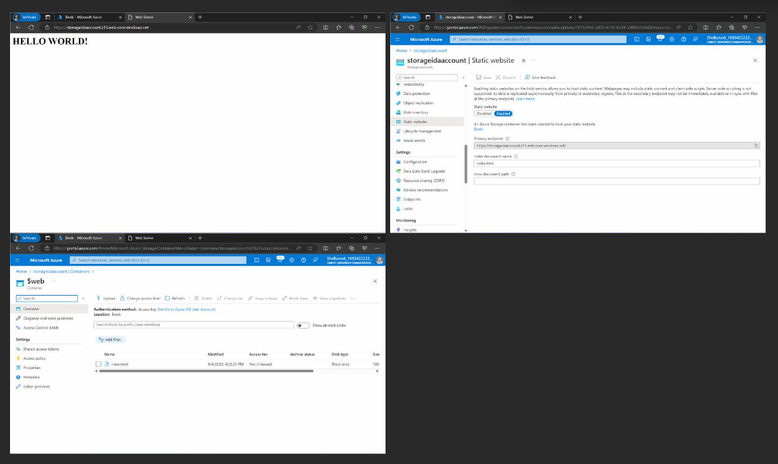

Slide 4
DAY-2
Access Keys : Lifetime
SAS (Shared Access Signature) : Time-bounded
Azure Key Vaults
Access Control (IAM) : Check Access Here
Azure Data Factory :
Data Engineer Activities:
ETL (Extract,Transform,Load)
ELT
Azure Databricks - Transformation
Data Orchestration
ADF Components:
Pipelines : Combination Of One Or More Activities
Activities
Datasets
Linked Services : To Access Particular Directory This Is Used.
Integration Runtime : Gateway Or Bridge To Connect For Data Extraction.
Azure Auto Resolved (Default)
Self-hosted
Azure SSIS
Triggers
Data Flow
Parameterization
Pipelines
Azure Storage Types- Day 2 & Azure Data Factory

Slide 5
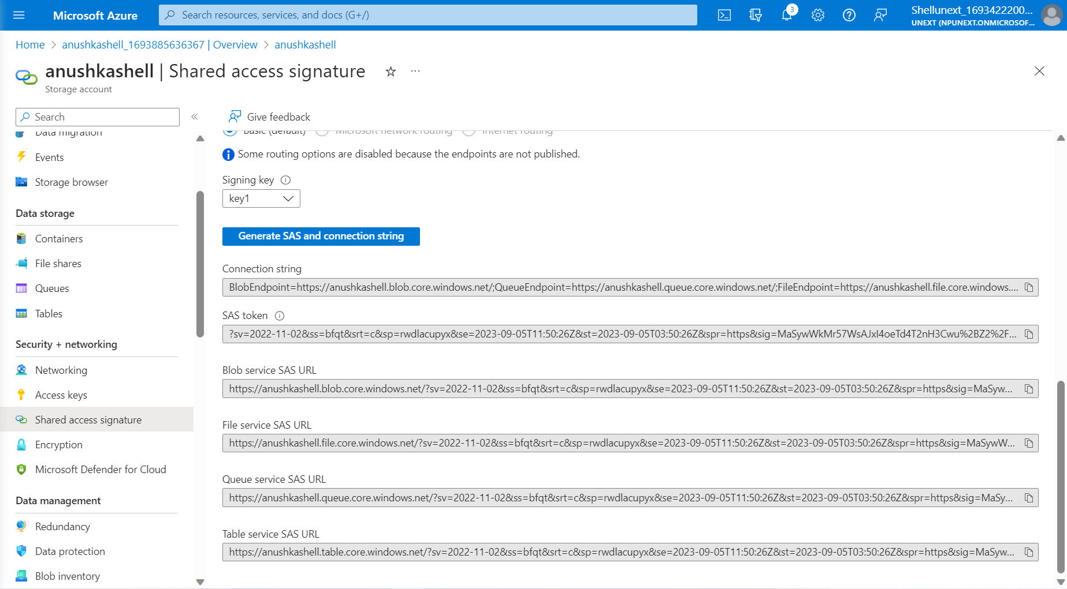
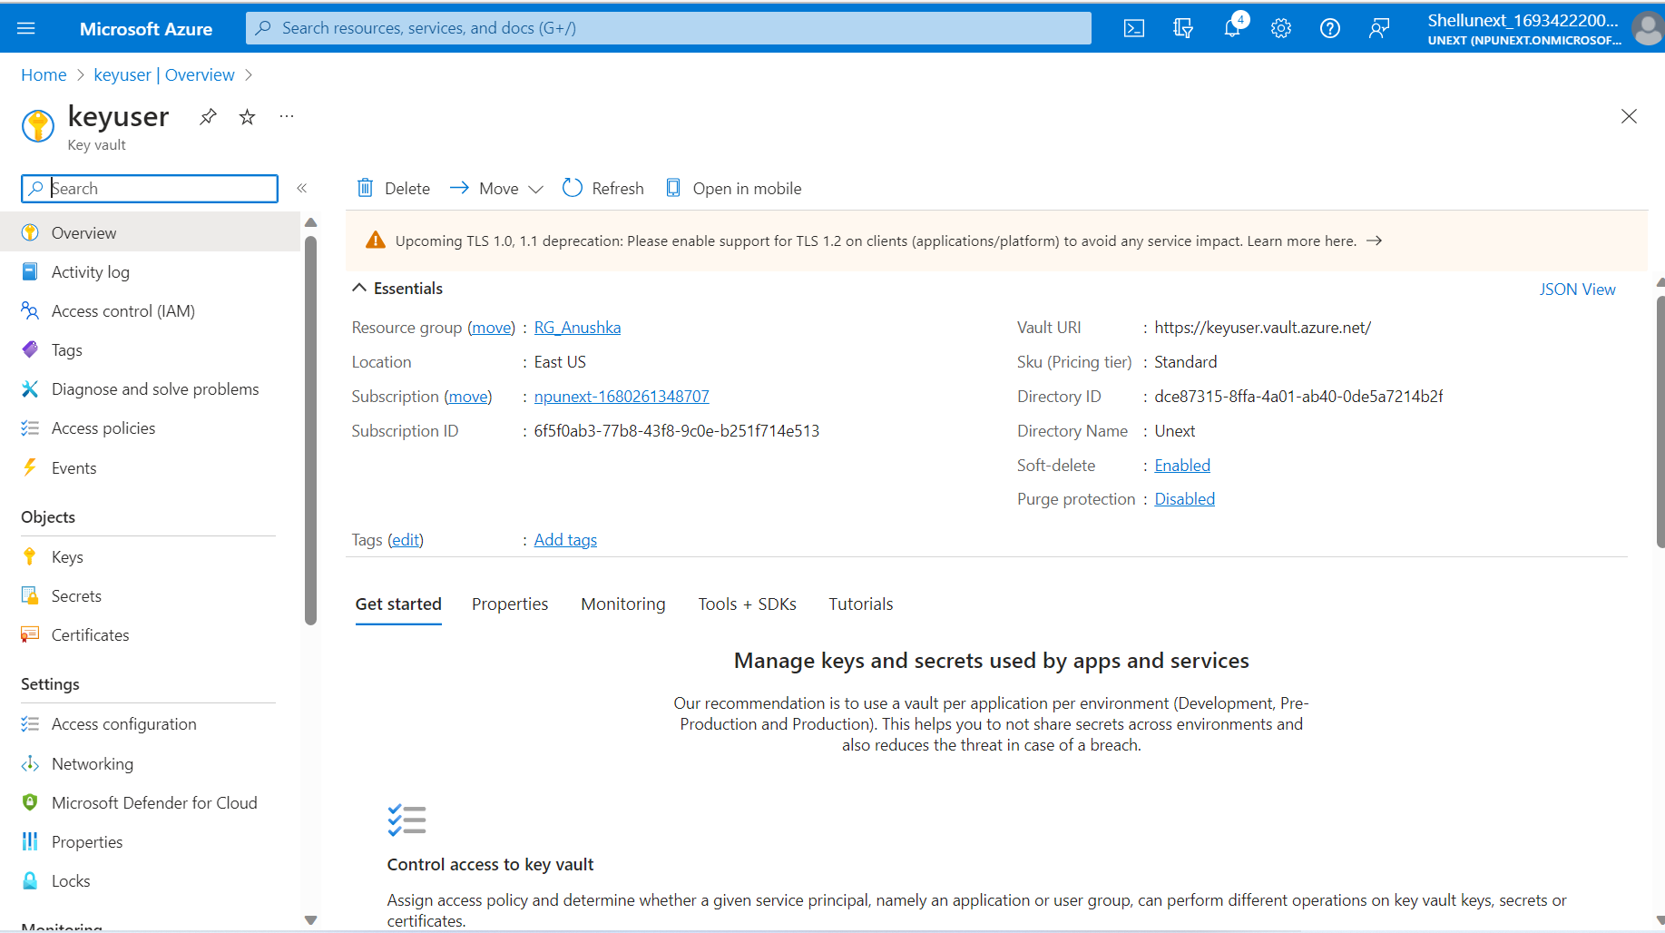
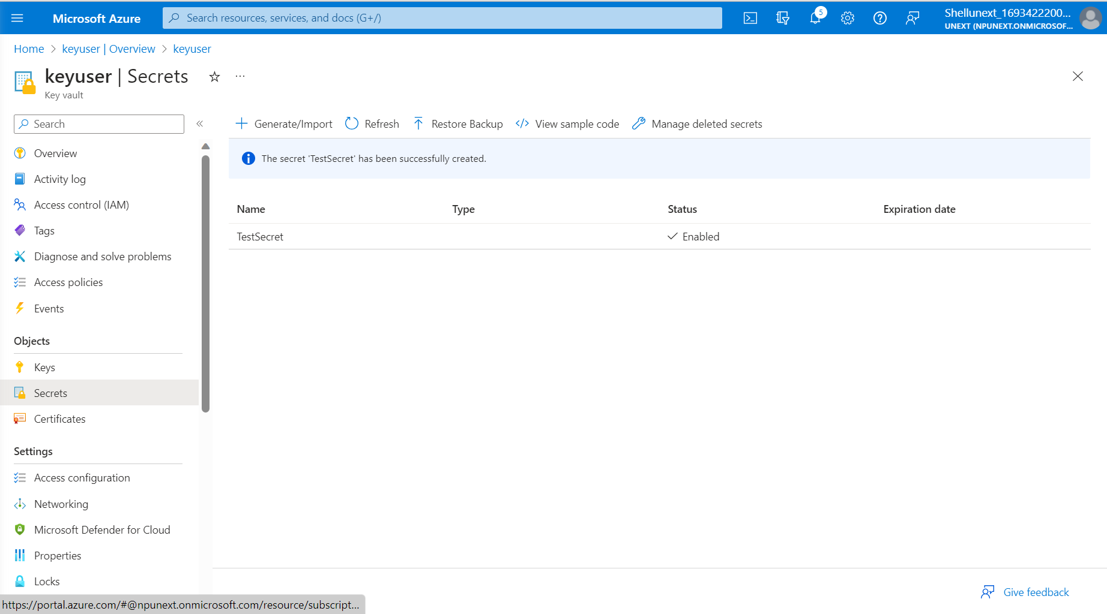
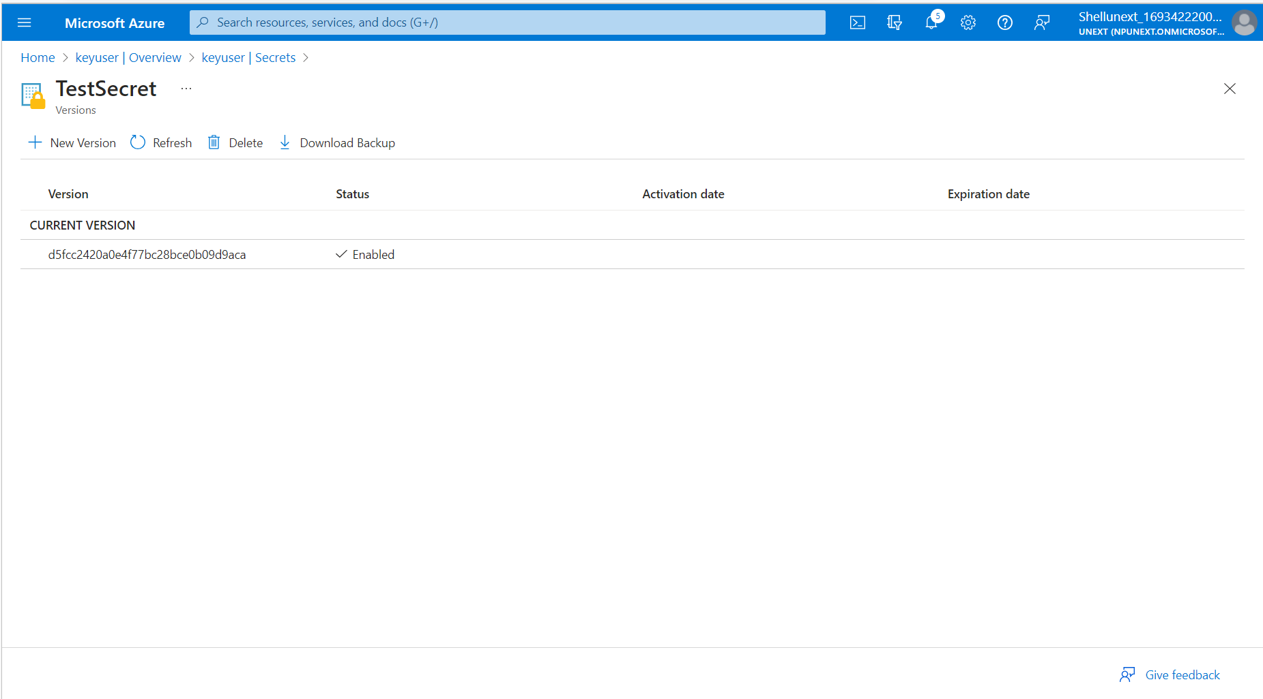
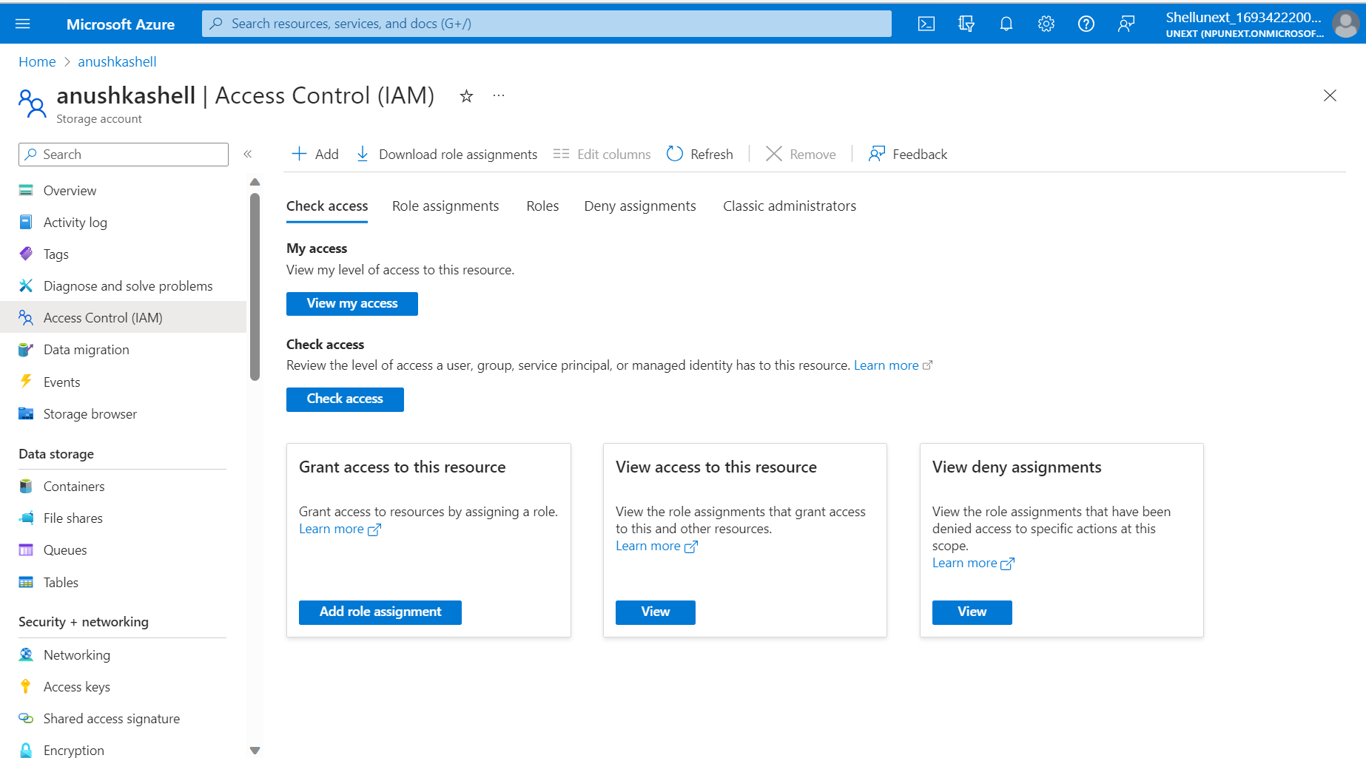
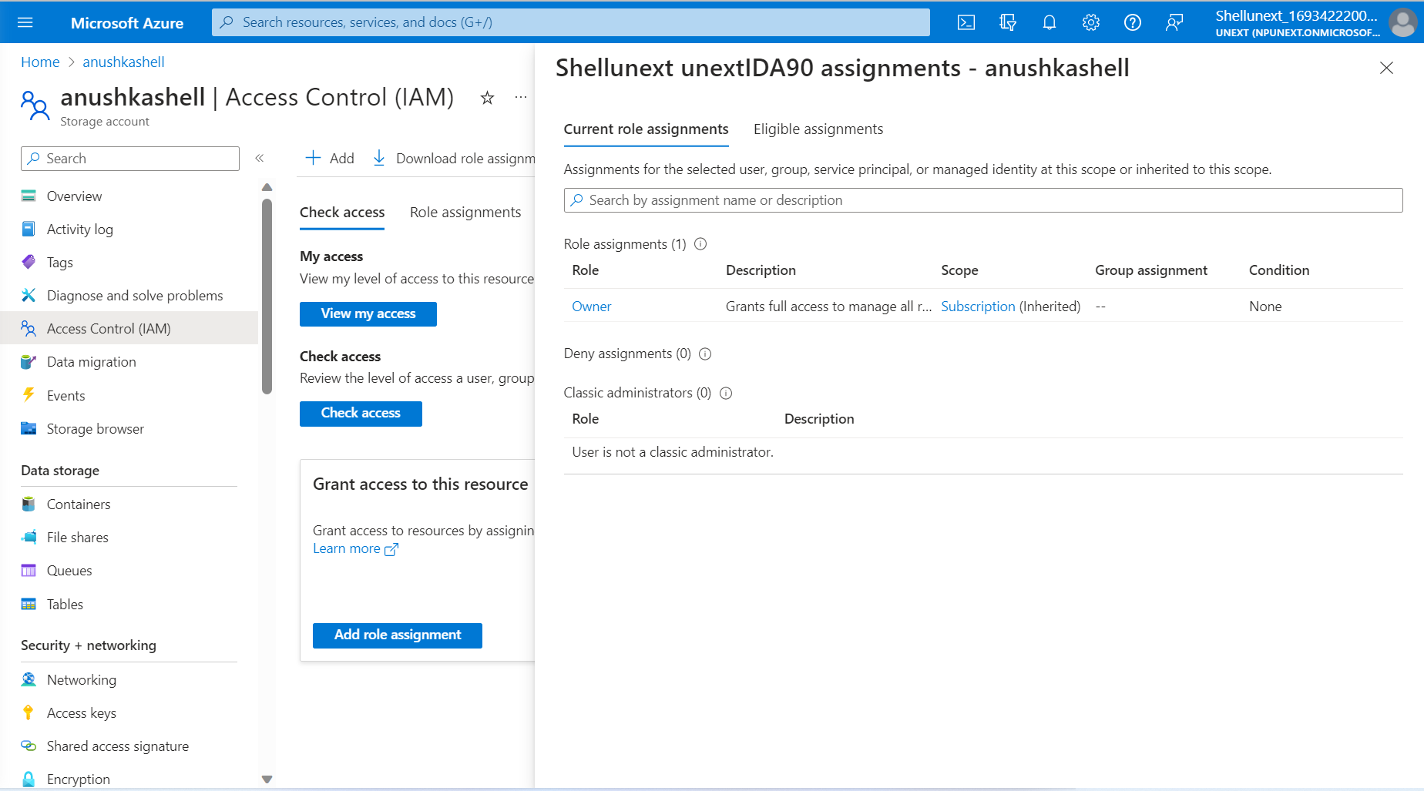
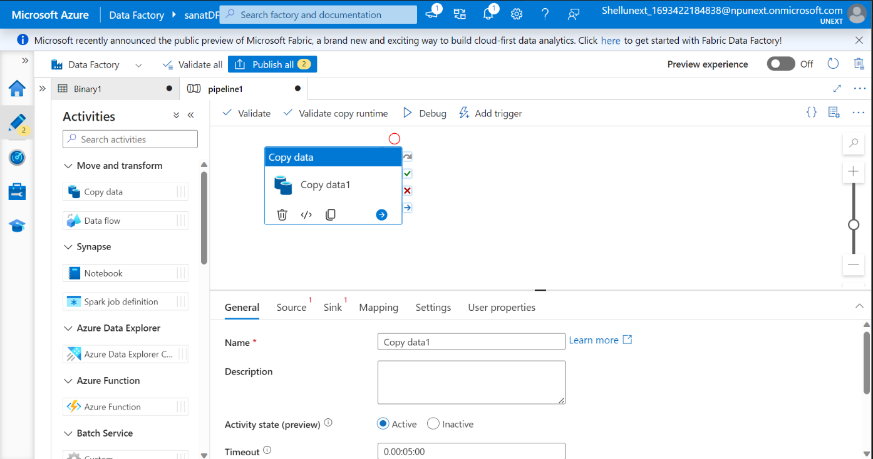

Slide 6
DAY-3
Create Data Factory
Activities In Pipeline :
String, Boolean, Array And Integer Activities In Pipelines
Execute Pipeline Activity
SSIS Package (Azure SSIS IR - Required For This Package)
Get Metadata Activity
Copy Data Activity Implementation
Parameter Concept Implementation
Triggers
Get Metadata Activity
If-else Condition For Get Metadata In Pipelines.
For Each Loop
Azure Data Factory - Day 1

Slide 7
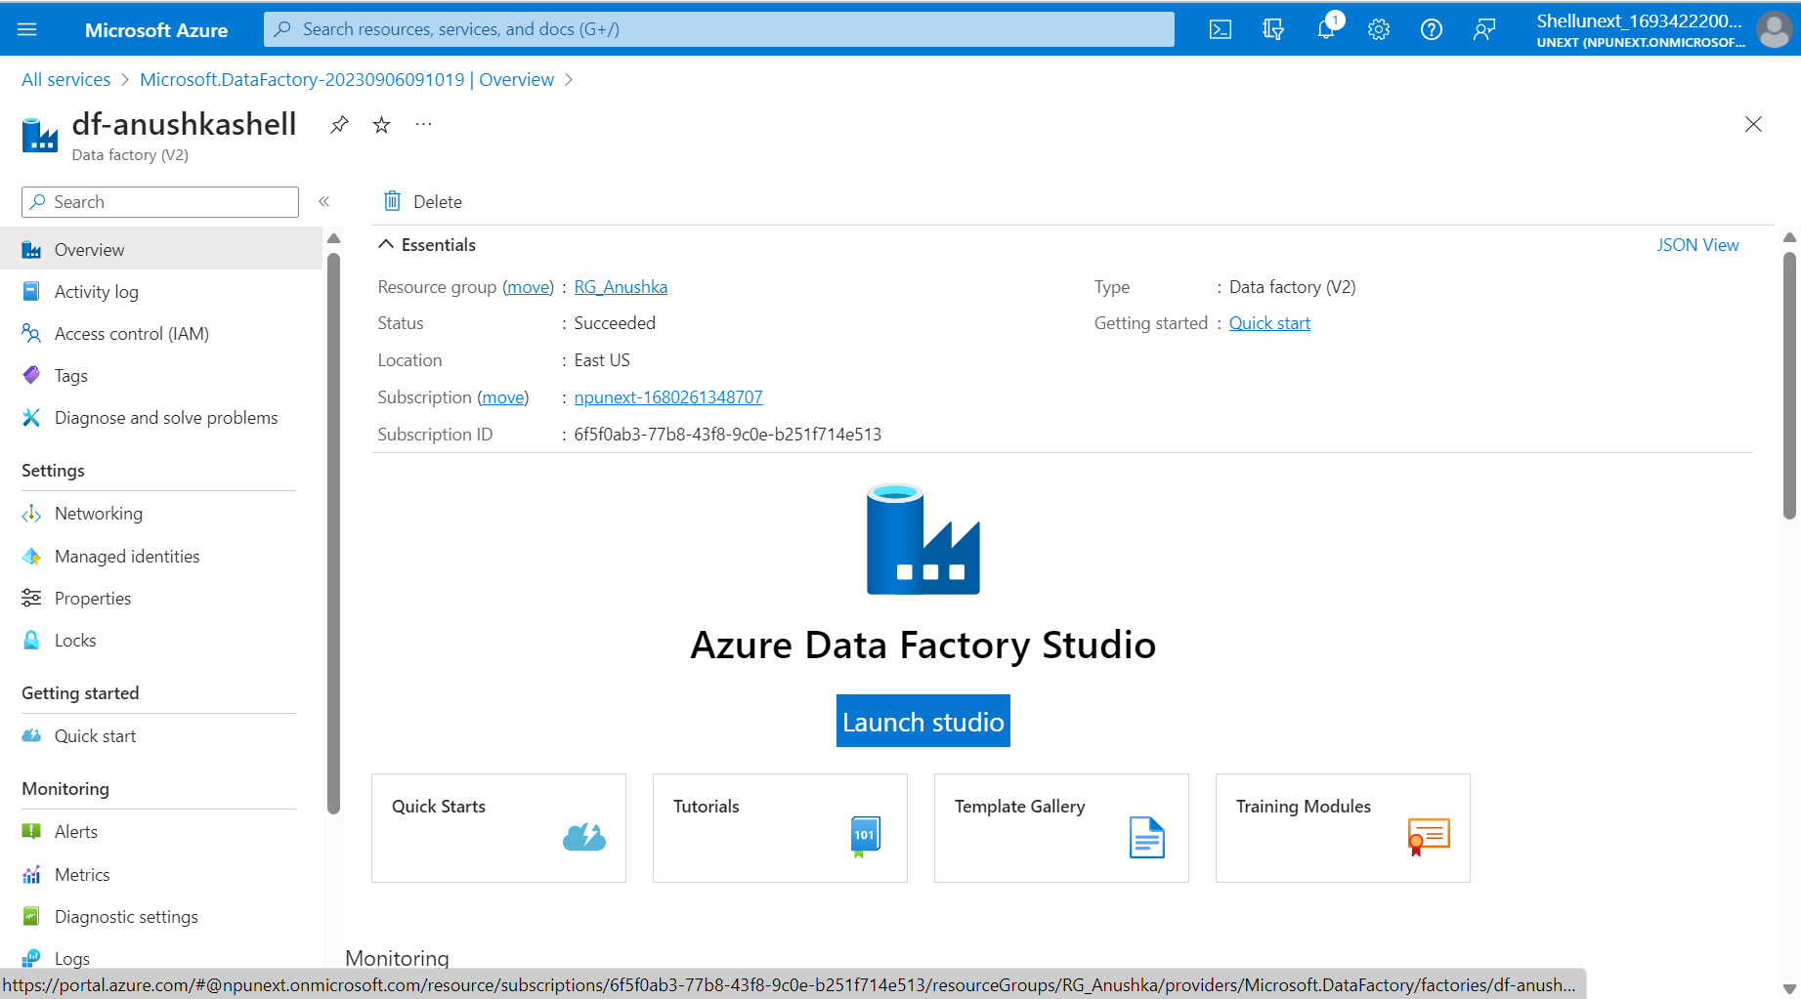
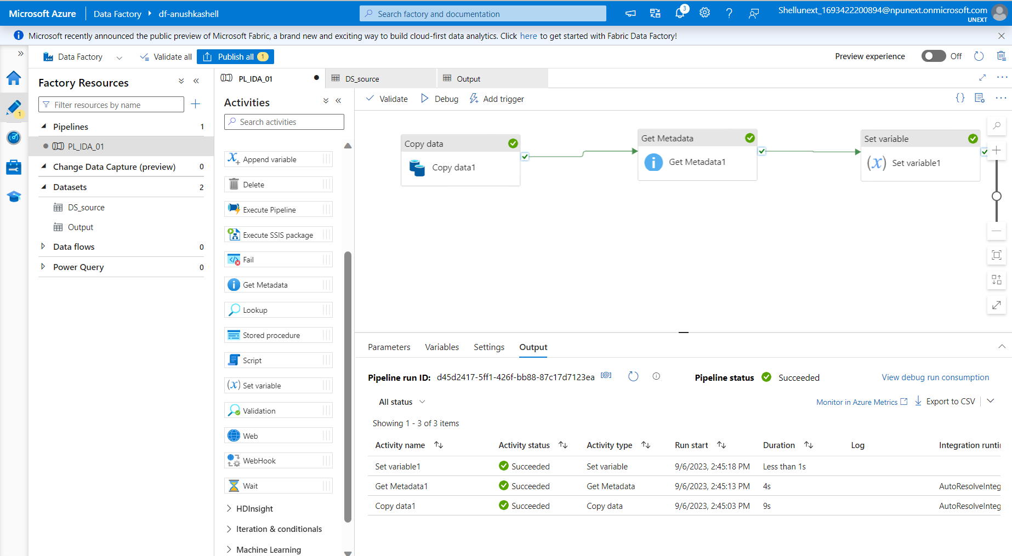
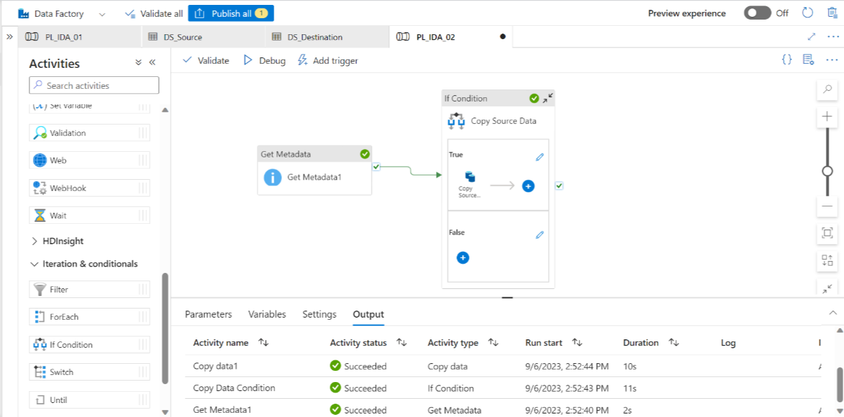

Slide 8
DAY-4
Data(resource)transformation Using Data Flow.
For Each Activity
Data Flows
Dataflow Expression Builder And Derived Columns
Surrogate Key
For Each Container And Get Metadata
API
Azure Data Factory - Day 2

Slide 9
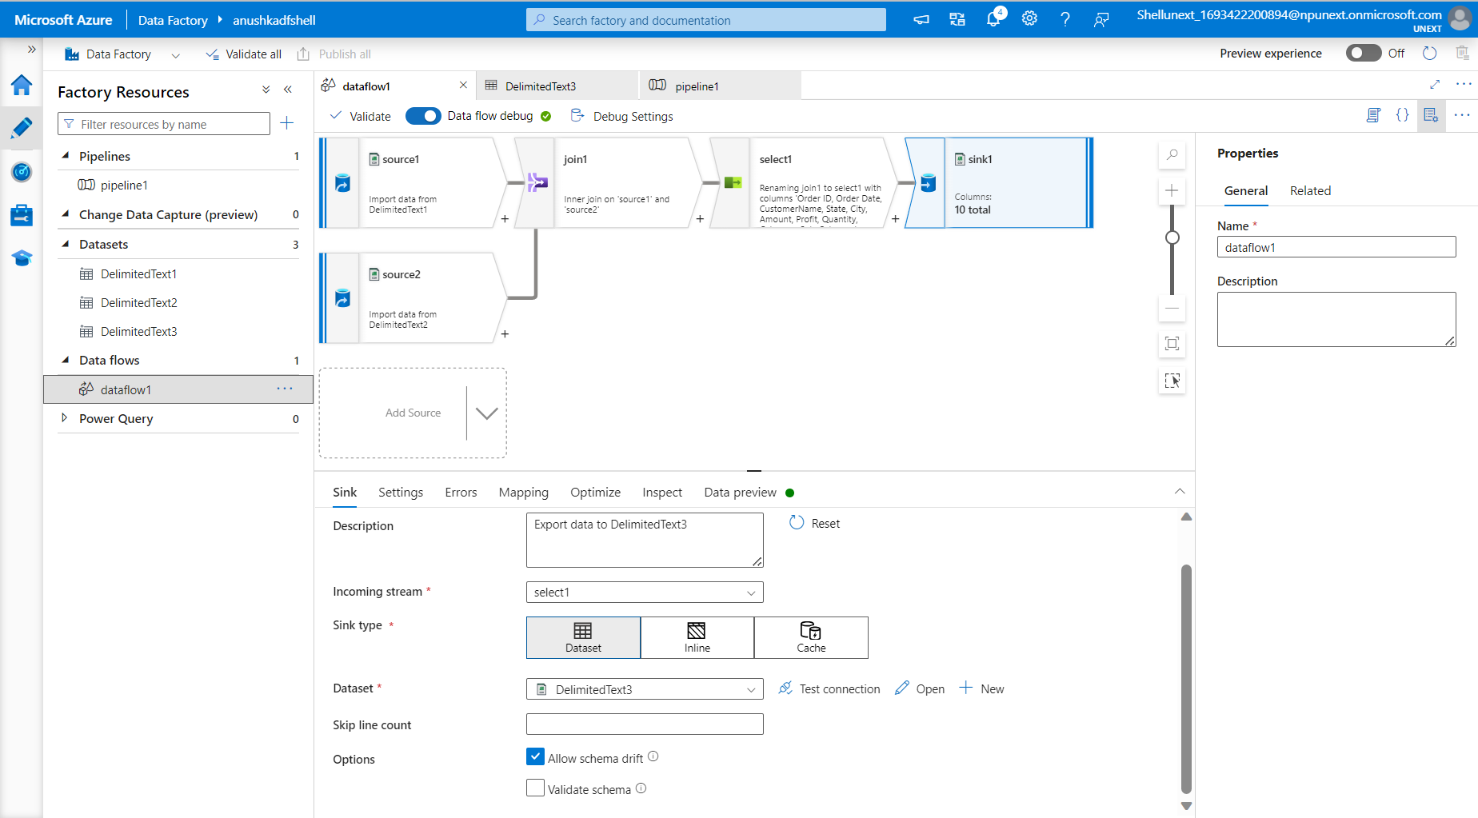
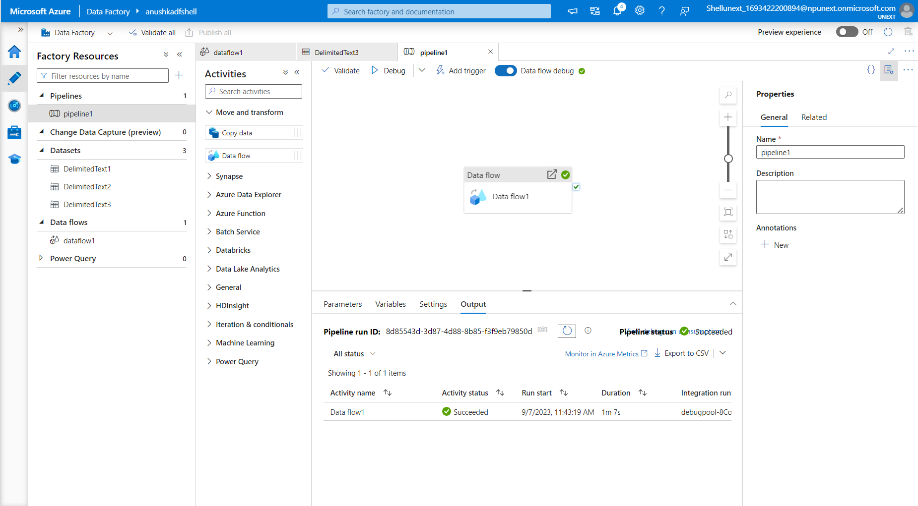
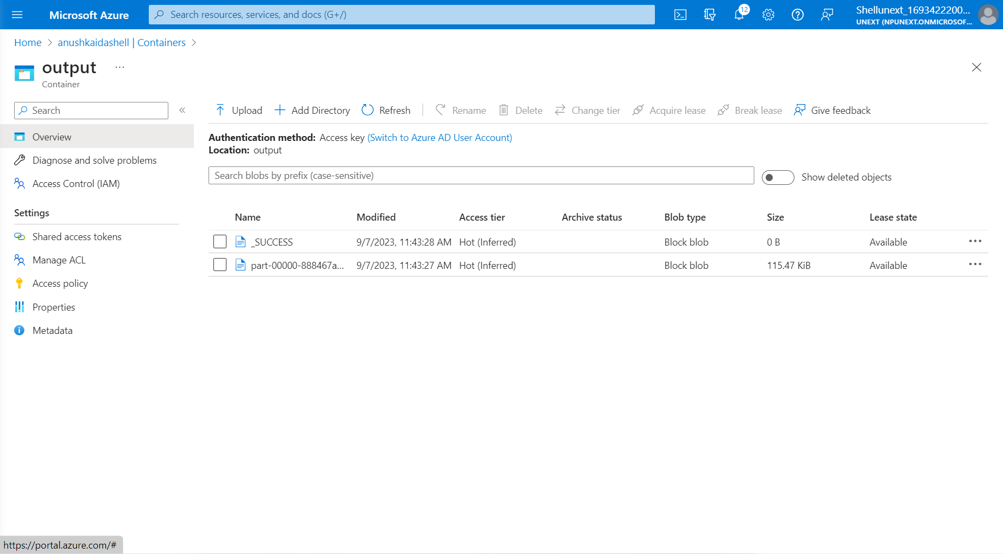
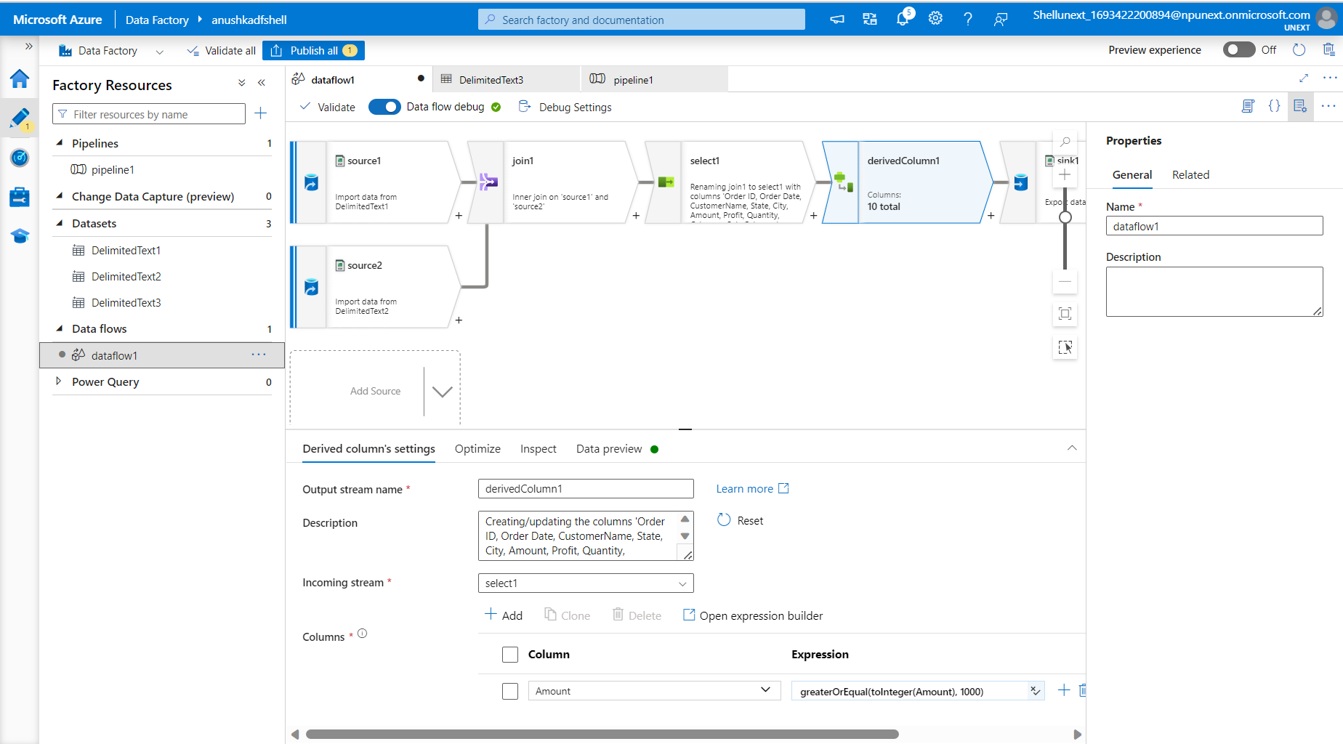
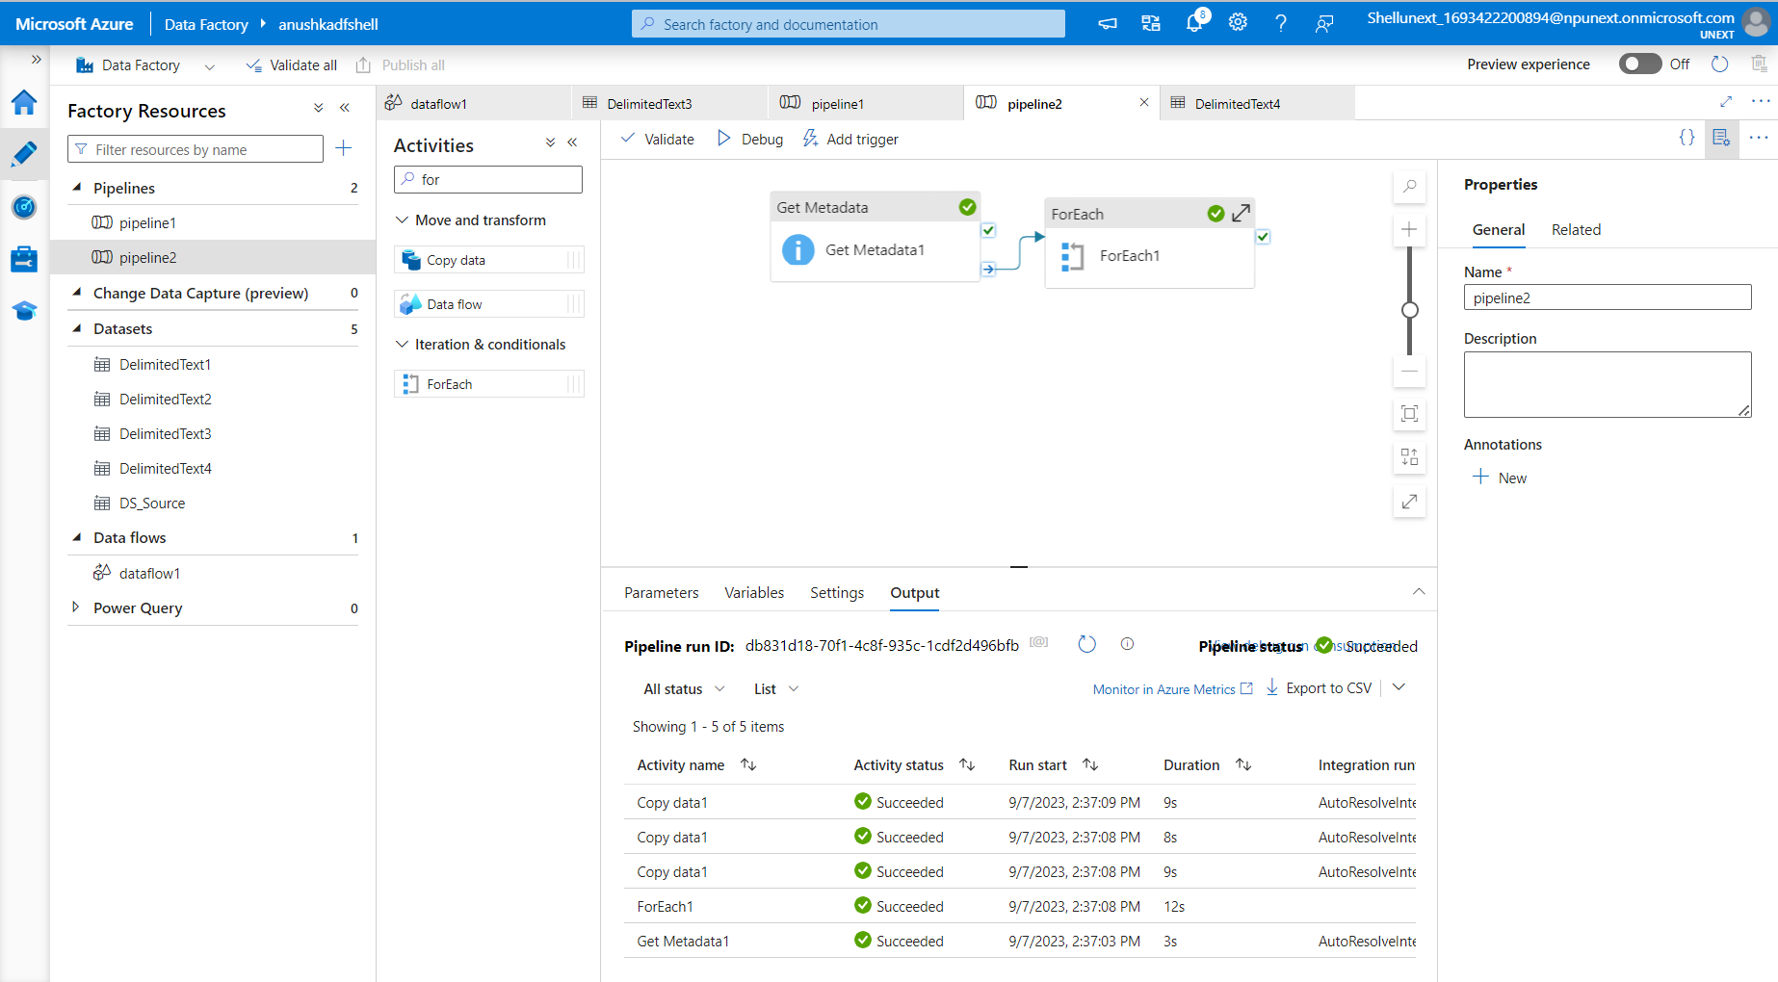
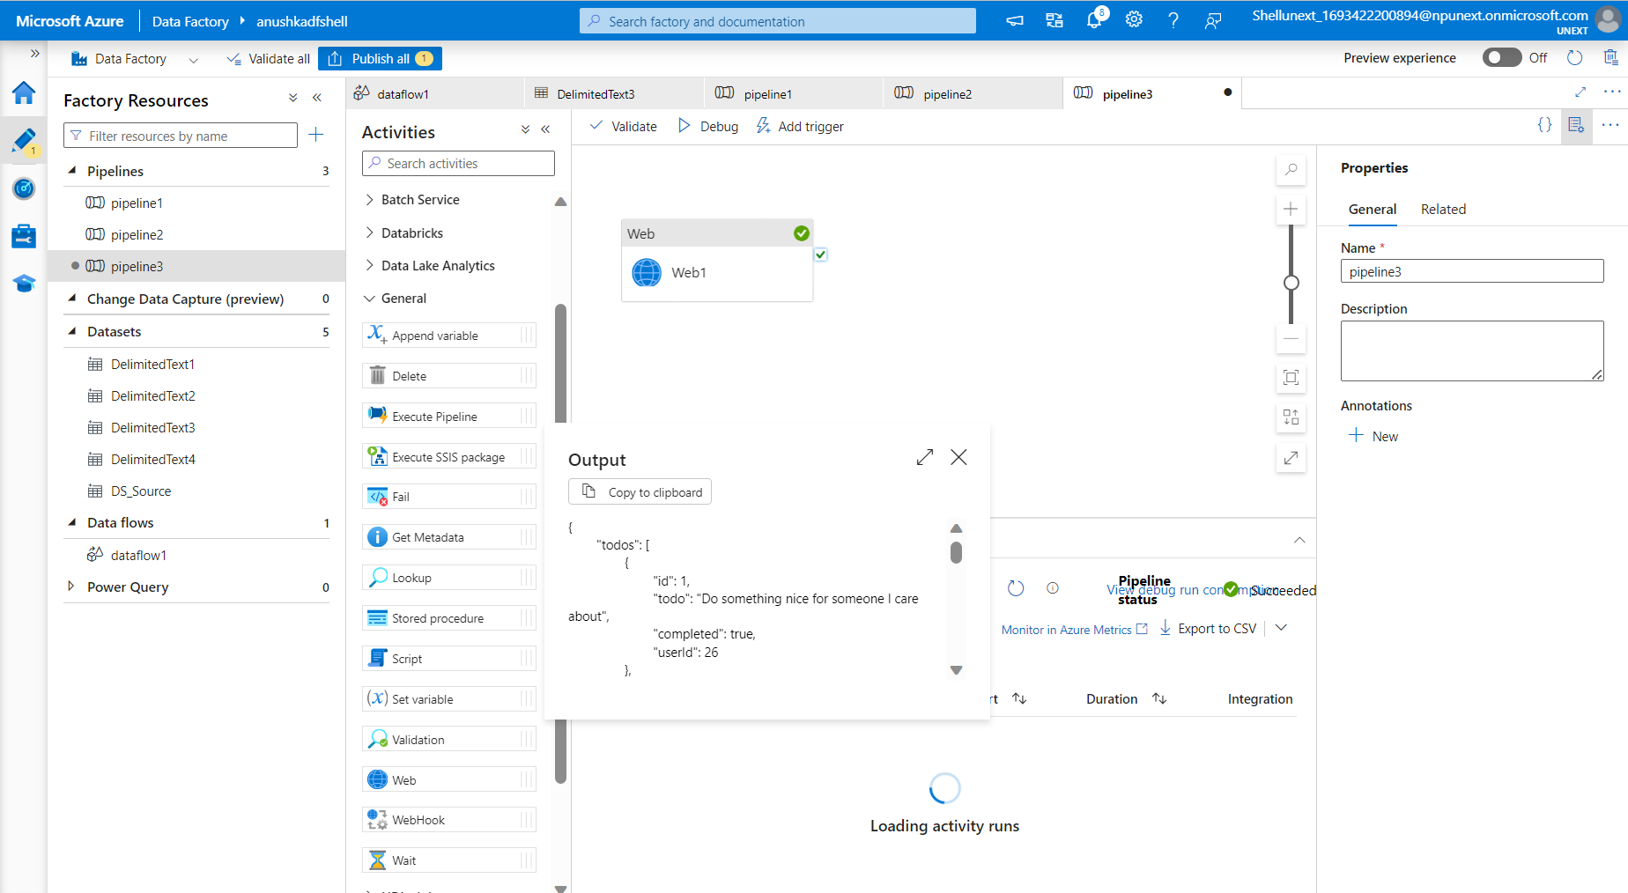
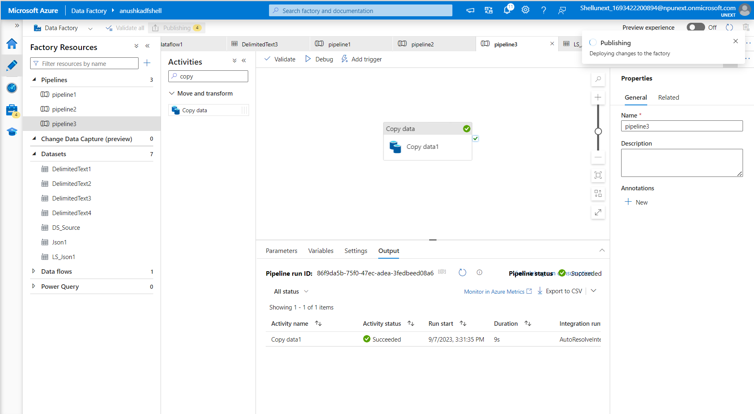

Slide 10
DAY-5
Create SQL Database On VM.
Lookup Table In Sql Database
Lookup Table With Foreach Pipeline
CDC (Change Data Capture)
Runbook Or Automation
Azure Data Factory - Day 3

Slide 11
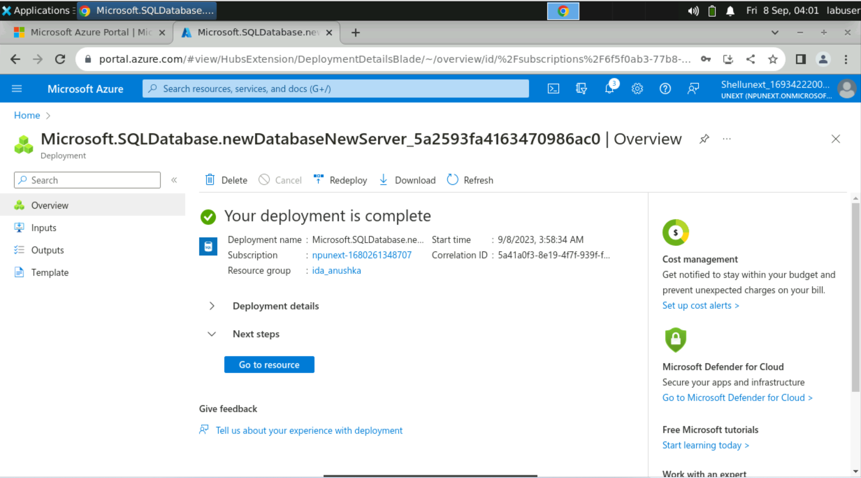
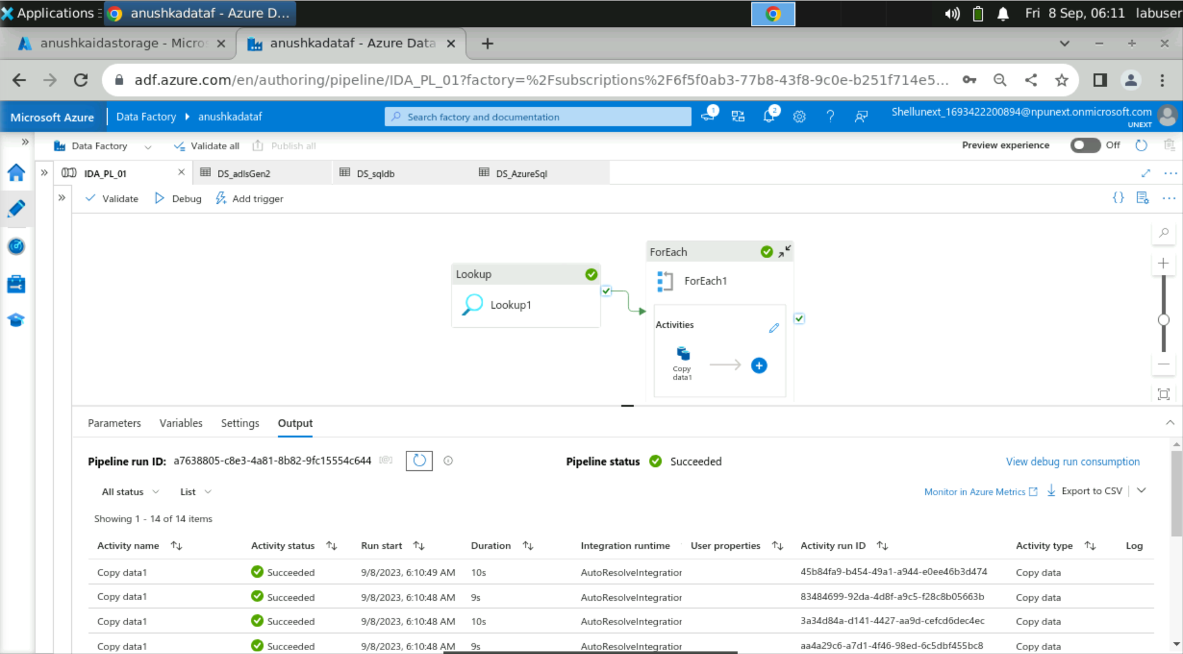
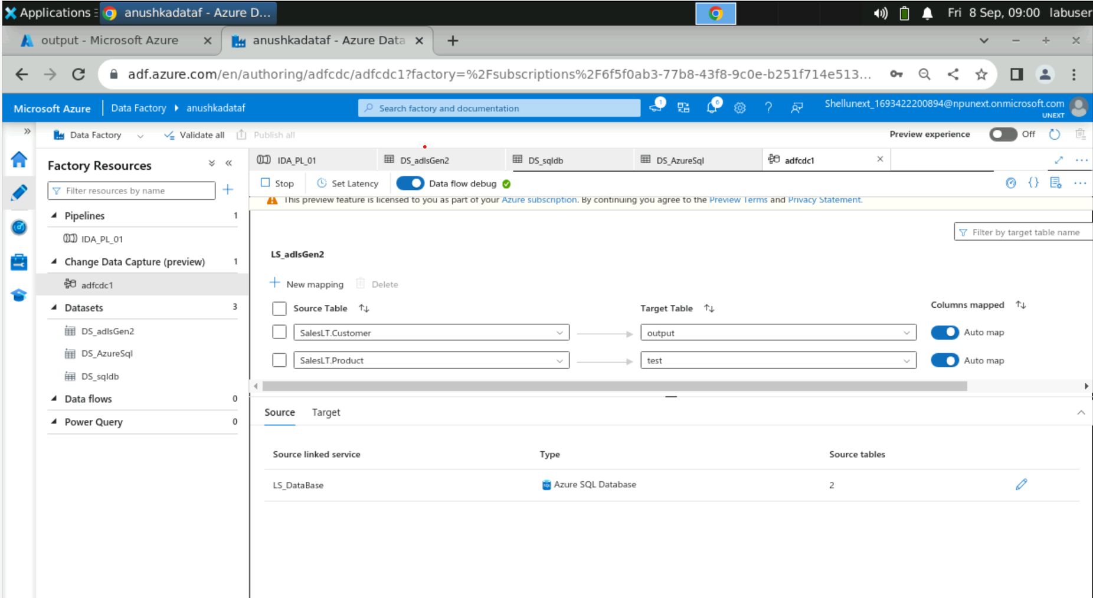

Slide 12
Thank You

